Slide 1
Creating Lists & Event Handlers
Creating schemas and behaviors for your content
Notes:
In this module you will learn how to create lists and event handlers using the SharePoint development tools in Visual Studio 2010. This module will also learn about the new events and event handler options introduced in SharePoint 2010.

Slide 2
Agenda
Relational Lists and Large List Support
Creating List Instances and List Definitions
Creating and Debugging Event Receivers
Document Libraries
Site Definitions

Slide 3
Relational Lists
SharePoint 2010 introduces the capability to have a relationship behavior enforced by Lookups
New investments:
Projected fields into child lists
Joins
Relational integrity between parent & child lists
Introduces new security considerations and possible issues
Notes:
In SharePoint 2010 you can use Lookup fields to enforce a relationship behavior between two lists.
In the SharePoint API there have been changes to make these relations possible. The SPList class has and additional method GetRelatedFields that returns a collection of type SPRelatedFieldsCollection. A field of type SPRelatedField has properties like FieldId, ListId, LookupList and RelationshipDeleteBehavior.
The SPQuery class has been extended with additional properties like ProjectedFields and Joins. The ProjectedFields property returns the related fields from the joined list, so that they can be referenced in the WHERE element and the ViewFields element. Each projected field is represented by a Field object. The Joins property includes Join elements. SharePoint allows inner joins and left joins.
When creating a lookup, you can enforce relational integrity between parent and child list in two ways:
Can enforce a cascade delete.
Can restrict delete relationships.

Slide 4
Relational Lists: Projected Fields
Projected Fields
Extra field pulled from parent list into view of child list
Via browser interface, users add a lookup from another list just like WSS 3.0…
Then, user can select a secondary lookup field to pull into the child list
Notes:
Projected fields are fields from a parent which are referenced and displayed in the child list.
When a user add a lookup field to a list, the user can select a parent list, just as in WSS 3.0. But additionally, the user can select one ore more additional fields from the parent list to be visible in the view.
These fields are read-only, but enable a more join-like view.

Slide 5
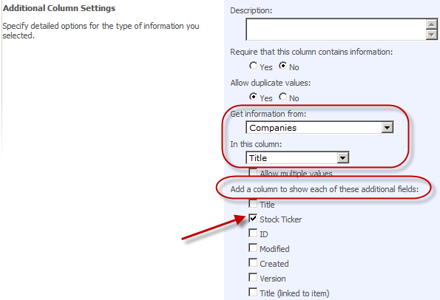


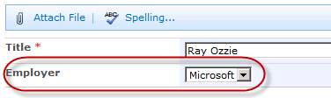
Relational Lists: Projected Fields
Notes:
When creating a new lookup field, the user selects the Companies list to select information from. Additionally the user chooses to also display the Stock Ticker field from the Companies list.

Slide 6
Relational Lists: Joins
With relational lists, SharePoint Foundation 2010 adds support for joins
Joins can only be implemented by developers using the API, CAML or SharePoint Designer 2010
New properties on SPQuery:
SPQuery.Join
SPQuery.ProjectedFields
Maximum number view fields selected for a joined of joins on a list view = six
Exception thrown if user tries to select fields from more than six fields from the joined lists
If no view fields specified (maximal view), only the first six pulled
Tip: Use LINQ to SharePoint instead of CAML to join two lists in code
Notes:
Joins can be implemented using CAML queries, but it is much easier to use LINQ.
CAML schema has been updated to support LINQ based joins.
LINQ will generate the CAML under the covers… LINQ is much easier to write than new CAML schema.
You can also create joins via API using two new properties on SPQuery: SPQuery.Join & SPQuery.ProjectedFields.

Slide 7
Large List Support
Urban legend of 2,000 items in a collection is still true
Primarily an issue with the view infrastructure
SharePoint 2010 adds self-monitoring protection against expensive queries
Expensive query: one that returns lots of data
Platform Investments:
Configuration options for administrators per Web application
Site collection & list administrators can request privileged operations (expensive queries)
Notes:
SharePoint can support lists with lots of data, but the larger the dataset, the bigger burden queries put on the server.
New controls for admins to block expensive queries: Central Admin offers additional configuration options that can be set per Web application.
Doesn’t help you view more data (doesn’t directly address the “2000 item issue”) but instead more of a heath & monitoring thing.

Slide 8
Large Lists (ctd.)
List settings page
When list count meets certain threshold List administrators will see warnings & messages when lists exceed thresholds
SPList.IsThrottled: when true, list contains more items than the configured limit to be considered a “large list”
Allow object model override
Enables developers to ignore query safety checks and run an unsafe query via SPQuery or SPSiteDataQuery
Requires special priv. 2 different limits:
Normal user – 5,000 items
Super user – 20,000 items
Configure time window when to allow expensive queries
Notes:
List throttling is one of the new features in SharePoint 2010. It enables to set a limit on how much records can be returned when a query is executed.
SharePoint will attempt to execute the query provided.
If query returns records in excess of 5,000 items, it will throw an exception saying it’s too big and it has been throttled.
Thus, SharePoint will ALWAYS try to run the query, but when it exceeds the threshold, it aborts it… even if the real result set would be 5,001 items.
Threshold configurable by Windows PowerShell.

Slide 9
Case Study: Querying Large Lists
Case study: query set to return 5,500+ items
SharePoint tries to retrieve the results like usual
When the result set counter hits 5,000, SharePoint throws an exception saying the query is expensive
Thus, SharePoint *tries* to run the query, but stops when deemed harmful to the server
Options:
Refine the query to pull back a smaller result set
Run the query during the “expensive query window”
Within the API disable throttling
Notes:
When a list exceeds the warning threshold, a message is displayed in the list settings page to warn the list admin the list is reaching the upper limit.
When list exceeds the upper limit, throttling kicks in.

Slide 10
Querying Large Lists
If throttling is enabled & list limit exceeded threshold, users won’t be able to query lists by default via API
Can override querying the large list settings provided Web App configured to allow it
Override using:
SPQuery.QueryThrottleMode
SPSiteDataQuery.QueryThrottleMode
Only users with proper permissions get override ability (set via policies)
Notes:
List throttling, which is triggered by exceeding the upper limit, will cause queries with a result set in excess of the upper limit to throw an exception.
However, this can be overridden by users with required permissions via code. SPQuery and SPSiteDataQuery contain a new property QueryThrottleMode that can be set to SPQueryThrottleOption.Override.
SPQuery query = new SPQuery();
query.QueryThrottleMode = SPQueryThrottleOption.Override;
Other values in the SPQueryThrottleOption enumeration are:
Default
Strict: Throttling for both the number of items and for number of Lookup, Person/Group, and Workflow Status fields will apply to the query regardless of user permissions.

Slide 11
Unique Column Constraints
Lists can now contain columns that require all values in all items in the list for that column to be unique
Scoped at SPList level, not SPFolder
Unique columns must be indexed
When making existing column unique, existing data is validated
Uniqueness determined by SQL collation
Ex: Case sensitive / insensitive
Notes:
In SharePoint 2010 you can indicate that a column must contain unique values within the list. This means that no duplicate values can occur in the list for that column. In SharePoint 2007, you could only enforce this by implementing an event receiver on the ItemAdding event.
A column can only be defined as unique when the column is indexed.
If applied on an existing column in an existing list, the action will fail if duplicate value are already present.

Slide 12
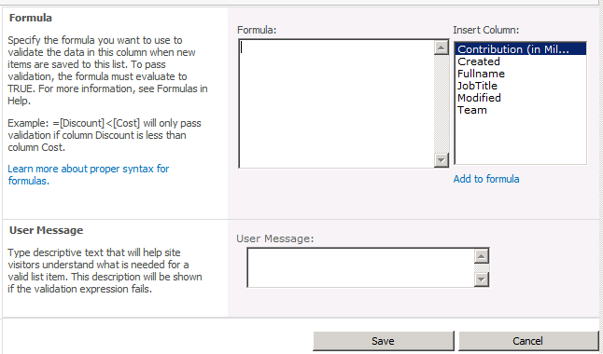
List Item Validation
Items are validated against a custom formula when saved
Notes:
Two new types of constraints on Lists & List Items in SPF2010: column-level & row-level
You can specify a validation condition when creating the column or from the list settings.
The List Settings page offers a new hyperlink in the General Settings section: Validation Settings.
This brings you to a page where you can enter a formula against which new list items are validated. The formula must evaluate to true to be able to save the new list item.
Example: [EndDate] > [StartDate].
In SharePoint 2007 you could only solve this type of validation by implementing an event receiver on the ItemAdding event.

Slide 13
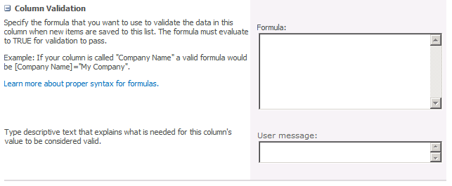
List Item Field Validation
Similar to list item validation, each column can be validated using a custom field, or by referencing other fields
Notes:
You can also achieve column validation when you create a new column or modify an existing column.
Notice the new section Column Validation where you can enter a formula against which the data entered in that column will be validated. The formula must evaluate to true before the list item can be saved.

Slide 14
Agenda
Relational Lists and Large List Support
Creating List Instances and List Definitions
Creating and Debugging Event Receivers
Document Libraries
Site Definitions

Slide 15
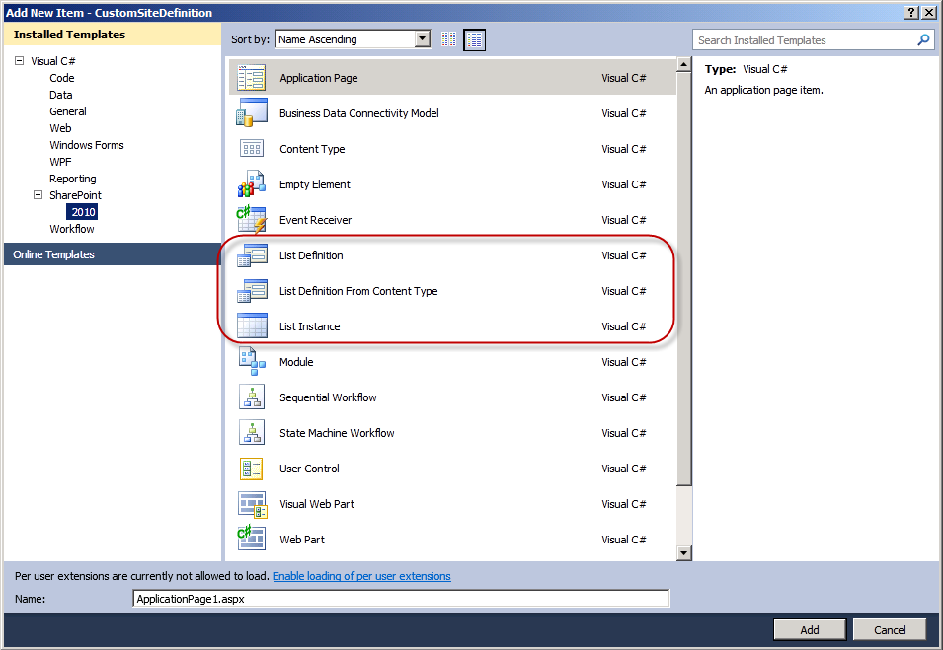
List Definitions & Instances
List Definition
Like a template for a list
Contains default content types, fields, views
List Instance
Actual list based off an existing list definition
Once created, not linked to the underlying definition
New SPI’s for list definitions & instances!
Notes:
Creating list instances and list definitions in CAML are a complicated and time consuming task in SharePoint 2007.
A List Definition is like a list template that can be used to create new lists or libraries. It contains default fields, content types and views. In CAML it is defined using the <ListTemplate> element. A list definition can range from very simple to very complex.
A List Instance is a list based on an existing list definition. In CAML it is defined using the <ListInstance> element.
The Visual Studio 2010 Tools for SharePoint 2010 make this task easier to accomplish.

Slide 16
Trick: Creating List Definitions & Views
Creating list definitions and views can be very challenging as it involves a lot of XML
One easier option / trick:
Create list definitions & views in the browser
Save the site as a template from site settings
Download the generated WSP file the Solution Gallery
Import the WSP with VS2010’s “Import WSP” template
Find the list definition & schema
Copy the necessary files to your project & do minor modifications (IDs, titles, etc)
Notes:
Creating list definitions, specifically the views, can be quite challenging. The reason for this is that they are comprised of a significant amount of XML in the schema.xml file and Visual Studio 2010 does not provide a designer for creating lists.
One way to mitigate this challenge is to use the browser as your designer. Create the list & views in the browser. Then export the site as a template & import it into a new Visual Studio 2010 project. This will give you easy access to the list’s schema and most importantly, the XML used to generate the views. Those can then be used within your project.

Slide 17
DEMO
Creating Custom List Definitions & List Instances

Slide 18
Agenda
Relational Lists and Large List Support
Creating List Instances and List Definitions
Creating and Debugging Event Receivers
Document Libraries
Site Definitions

Slide 19
New & Improved Events
New events in SharePoint 2010:
WebAdding & WebProvisioned
ListAdding & ListAdded
ListDeleting & ListDeleted
New Registration Capabilities
Site collection level event registration to support new events
SPSite & SPWeb event receiver registration via Features: new issue with SPSite or SPSite.RootWeb in registration
<Receivers ListTemplateId=“” Scope=“” />
Notes:
There are a lot of new events in SPF2010 based on customer demand around the creation of lists & SPWeb’s.
The ListAdding and ListDeleting events are synchronous events, while the ListAdded and ListDeleted events are asynchronous.
The WebAdding event executes synchronously, while the WebProvisioned event executes asynchronously.
These new events require new registration scopes & capabilities. Feature-based registration introduces a SCOPE=“” attribute.

Slide 20
Post Synchronous Events
WSS 3.0 “after” events are exclusively asynchronous
Problem when wanting to do post processing after item submitted, but before displaying to user
SharePoint 2010 adds new property on receiver definition to change “after” event to synchronous
SPEventReceiverDefinition.Synchronization
Notes:
SPF2010 introduces concept of synchronous post-events.
Allows developer to do a little post-processing after the commit of the action, but before user is presented with the result of the post.

Slide 21
Cancelling Events & Custom Error Pages
WSS 3.0 provided capability to cancel synchronous events & returning an error message
SharePoint 2010 introduces capability to cancel error and redirect user to custom error page
Not possible on post synchronous events
Synchronous cancel with error URL
Only work within the SharePoint browser user interface
Won’t work with Office clients (any version)
Notes:
SPF2010 now allows developers to point to a custom error page rather than leverage the existing WSS 3.0 based “_layouts” stock page with an error message.
Enables for more user-friendly error messages.
This only works in the SharePoint web interface. It doesn’t work with Office clients triggering the events.

Slide 22
DEMO
Creating Custom Event Receivers

Slide 23
Agenda
Relational Lists and Large List Support
Creating List Instances and List Definitions
Creating and Debugging Event Receivers
Document Libraries
Site Definitions

Slide 24
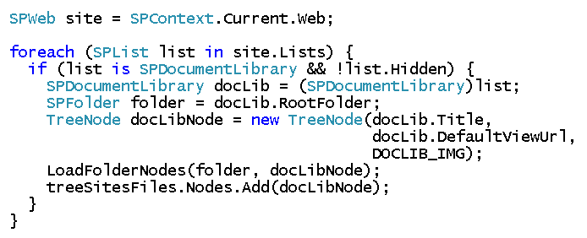
Document Libraries
Document Libraries are specialized lists
SPDocumentLibrary inherits from SPList
Document libraries can do everything lists can do
Notes:
A document library is of type SPDocumentLibrary and inherits from SPList. When you loop through the collection of SPList objects, you can cast a document library to SPDocumentLibrary:
SPDocumentLibrary docLib = (SPDocumentLibrary)list;
It has some specific child objects like SPFolder and SPFile.

Slide 25
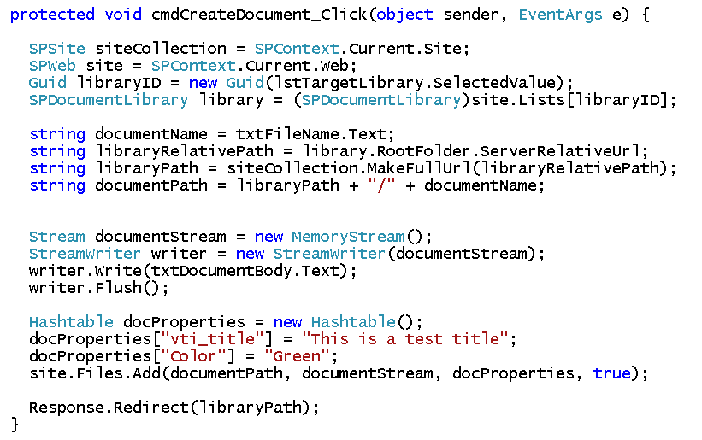
Programmatically Adding Files to Document Libraries
Notes:
You can programmatically add files to a document library using the SharePoint object model.
Read the file using a MemoryStream and pass the stream to the Files.Add method. This add method requires 3 arguments:
The path indicates to which document library the file must be added.
The memory stream containing the document.
When a file is added to a document library, a list item is created at the same time. You can set it’s properties by passing a hastable, where the key is set to the column name.

Slide 26
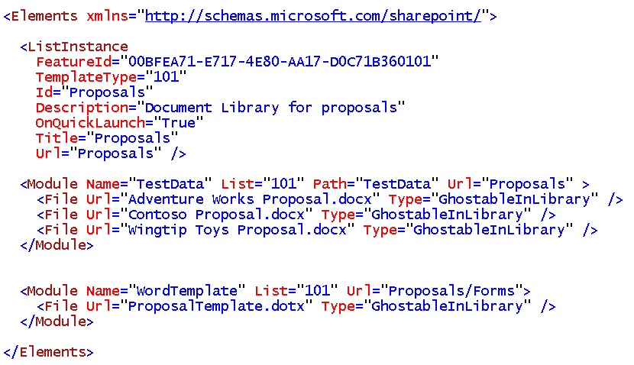
Provisioning Document Libraries
Notes:
When working with features, you can provision a document library on feature activation.
The <ListInstance> element creates the list. The TemplateType indicates that a document library will be created.
The first <Module> element populates the document library with a number of Word documents.
The second <Module> element uploads a Word template that will be used when the user chooses the New button to create a new document.

Slide 27
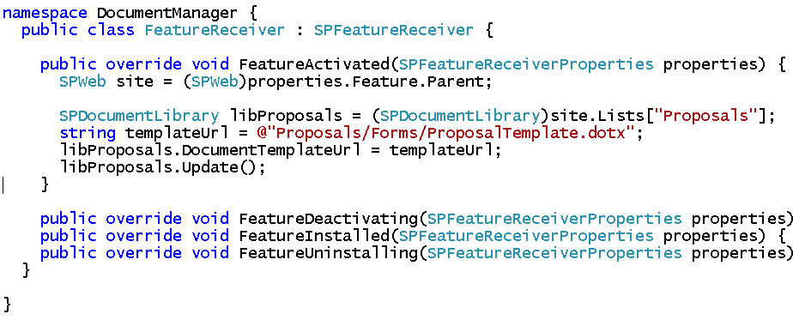
Configuring Document Templates
Each library can have one or more document templates
Usually defined by content types
Provision templates to library’s /Forms subfolder
Provision as Ghostable (not GhostableInLibrary)
Notes:
A document library can have one or more document templates. When a user clicks the New button, the decision on which document template to use is usually defined by the content types added to the document library.
If you want to provision document templates on feature activation, you have to deploy the template(s) to the /Forms subfolder of the document library.
The previous slide provides a document template using CAML while this slide demonstrates how to provision a document template within the FeatureActivated event handler of the FeatureReceiver class using the SharePoint object model.

Slide 28
Agenda
Relational Lists and Large List Support
Creating List Instances and List Definitions
Creating and Debugging Event Receivers
Document Libraries
Site Definitions

Slide 29
What is a Site Definition?
Top-level component for site provisioning
Used to create site templates
Aggregates smaller, more modular definitions
Every site is provisioned from a site definition
The association remains in place for lifetime of site
Each site definition has one or more configurations
Each configuration can serve as creatable site template
Notes:
A site definition is the top-level component that aggregates smaller, more modular definitions to create a complete site template that can be used to provision sites. For example, a site definition usually includes a custom page template for the site’s home page and can additionally reference external features to add support for custom lists, secondary pages, web parts, and so on.
Every site is provisioned from a specific site definition. Once a site is provisioned from a particular site definition, it picks up a dependency on that site definition that remains in effect for the lifetime of the site.
A site definition contains one or more configurations. These configurations are what appear to users as creatable site templates.

Slide 30
What files make up a Site Definition?
ONET.XML
Acts as manifest for site definition
WEBTEMP.XML
Language-specific file used to activate site definition
Page template files
Used to provision home page and secondary pages
Notes:
A Site Definition consists of diferent parts:
ONET.XML: the ONET.XML file serves as the manifest for the site definition and references the components that are to be used, like the features that define list types that need to be available to users to create new lists.
WEBTEMP.XML: This file references configurations in the ONET.XML file. Each WEBTEMP.XML contains a set of <Template> elements and each <Template> element contains a set of <Configuration> elements. These files list the different site definitions.
Page template files: these files are used to provision the home page and the secondary pages.

Slide 31


Create A Site From A Site Definition
Create a new site from Team Site template
Using default configuration for STS site definition
Create a new site from Blank Site template
Using explicit configuration from STS site definition
Notes:
You can create a new site from a site template using the Windows PowerShell cmdlet New-SPSite. You have to specify the following arguments:
URL: this is the URL where you want to create the newsite.
OwnerAlias: the owner of the new site.
Template: the name of the template you want to base your new site on. If you only specify the name of the template, the default configuration will be used to create the site. You can explicitly specify the configuration by adding a # sign to the template name and the number of the configuration you want to use.
Name: the name of the new site.

Slide 32
The Global Site Definition
Contains global provisioning instructions
What's inside affects provisioning for every site in farm
Eliminates redundant markup required in all templates
Global Site Definition defines and provisions
Master Page Gallery and default.master
Web Part Gallery
List Template Gallery
Site Template Gallery
Solution Gallery
User Information Profile list
Notes:
The Global site definition contains global provisioning instructions that are required by every site definition. The Global site definition contains more than 2600 lines of required common components, like base types and galleries. This way redendant markup is eliminated from the different site definition.
The Global site definition is located in the 14\TEMPLATES\GLOBAL folder and its subfolders. It contains a number of master page templates like default.master, v4.master and minimal.master.

Slide 33
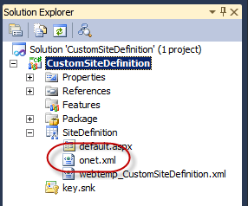
Developing Site Definitions
Visual Studio 2010 SharePoint Tools now contain a Site Definition project template!
Notes:
Creating your own custom site definition is a huge and complex task. Visual Studio 2010 SharePoint Tools contain a project template that helps you with the creation of a Site Definition. It creates the structure and adds the necessary files for you, containing an invaluable code skeleton.

Slide 34
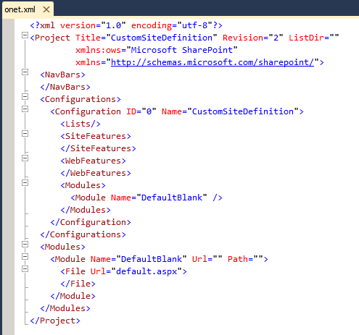
ONET.XML
Provides top-level provisioning instructions
Notes:
This code sample shows the code contained in the ONET.XML when you create a site definition using the Visual Studio 2010 Tools for SharePoint 2010. It contains the necessary elements like NavBars, Configurations and Modules.

Slide 35
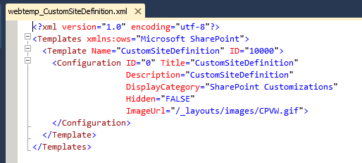
WEBTEMP*.XML
Notes:
This code sample shows the code contained in the WEBTEMP_*.XML when you create a site definition using the Visual Studio 2010 Tools for SharePoint 2010. It contains one <Template> element with one <Configuration> element.

Slide 36
Summary
Relational Lists and Large List Support
Creating List Instances and List Definitions
Creating and Debugging Event Receivers
Document Libraries
Site Definitions

